Slide 1

BookIT Appointment Booking System

Slide 2
Problem Statement . Manual appointment scheduling is time-consuming and may cause scheduling conflicts. This project provides a secure online platform for appointment booking and management.
. Challenges
Long waiting times
Manual record maintenance
Scheduling errors
Poor appointment tracking
Lack of online accessibility
. Need for the Project
To provide a secure and user-friendly platform that simplifies appointment scheduling and management for both users and administrators.

Slide 3
Methodology / Approach
.Technologies Used
-Frontend -Backend -Database
React.js Spring Boot MySQL
HTML5 Spring Security
CSS3 REST APIs
JavaScript
.Working Process
- User Registration/Login
- Authentication using JWT
- Browse Available Services
- Book Appointment
- Store Data in MySQL
- Admin Manages Appointments and Users

Slide 4
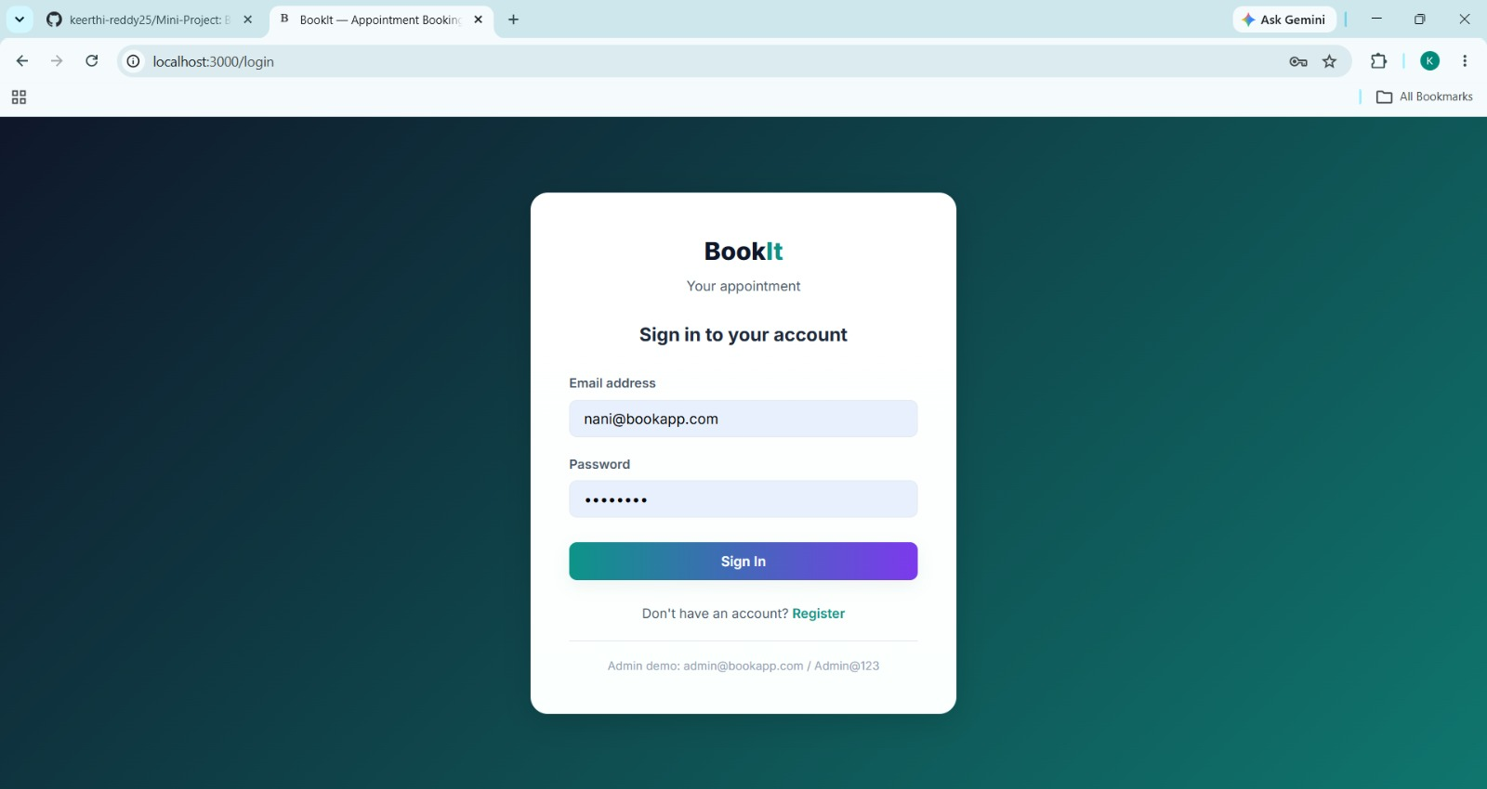
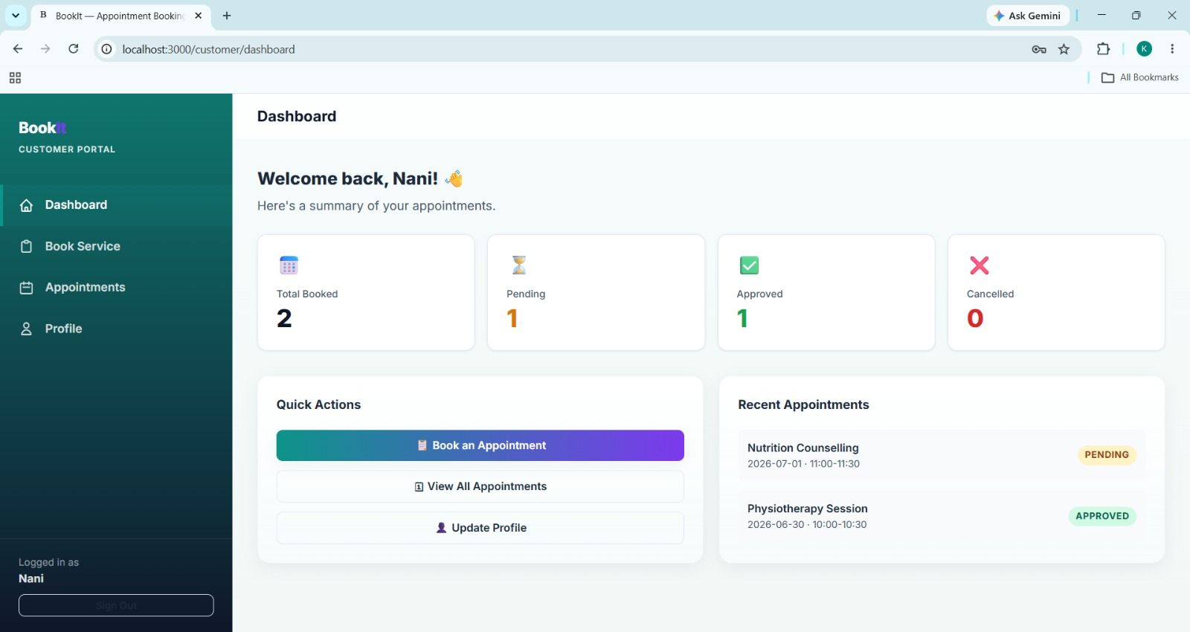
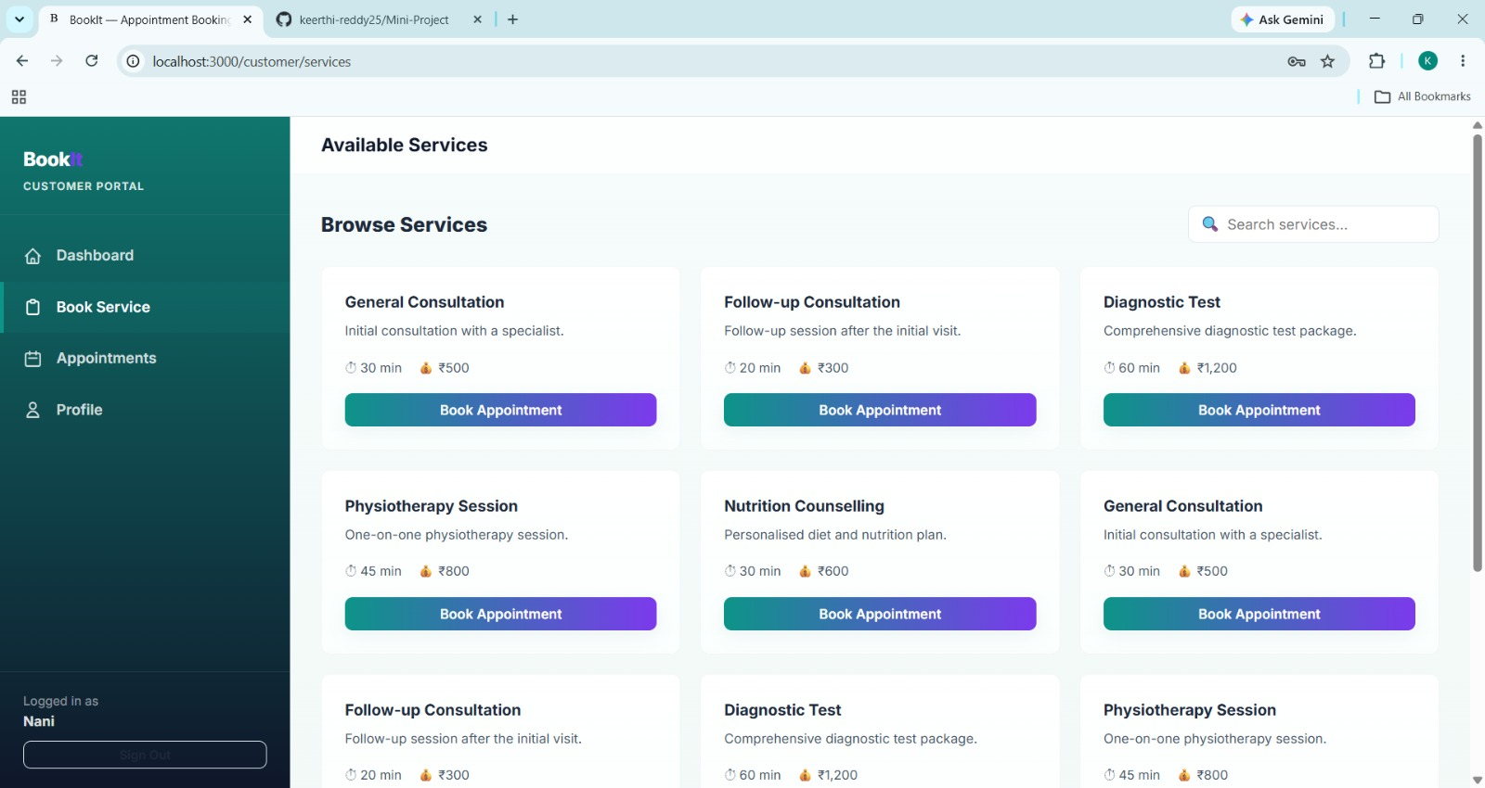
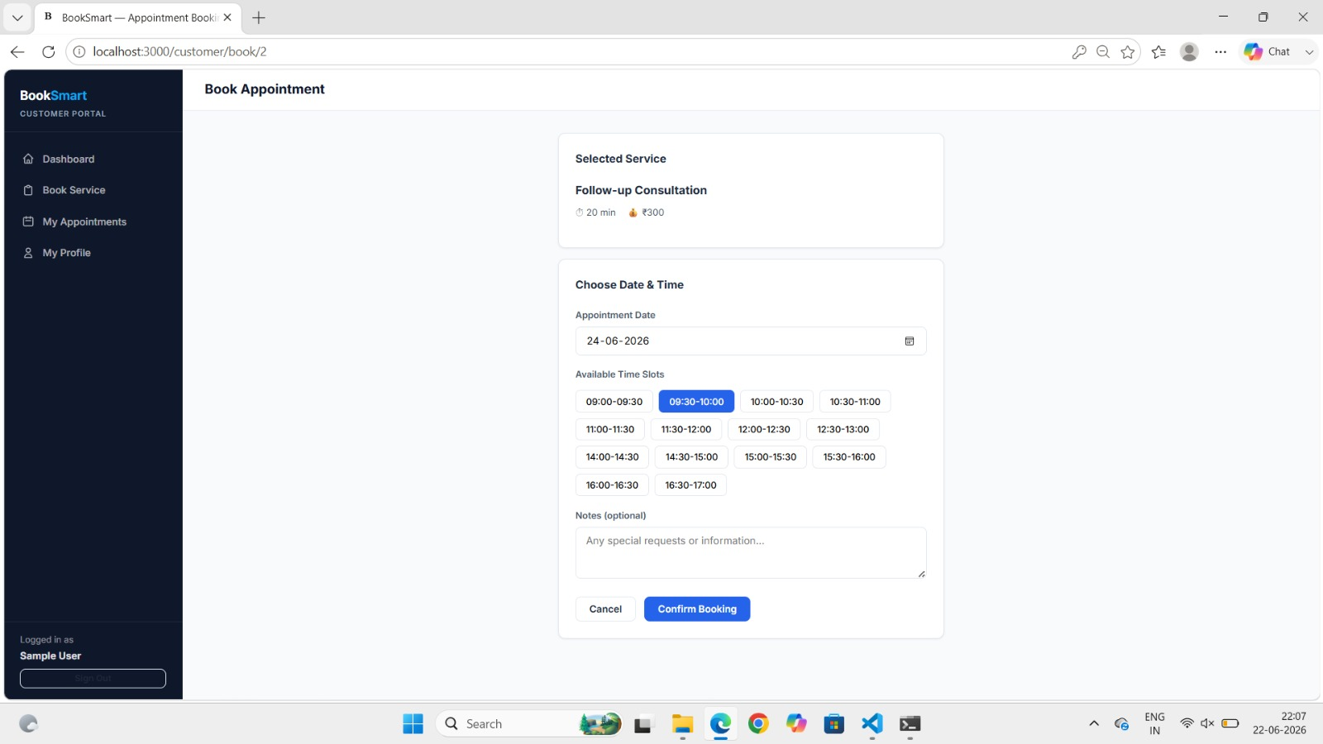
Results/Outcome User Login

Slide 5
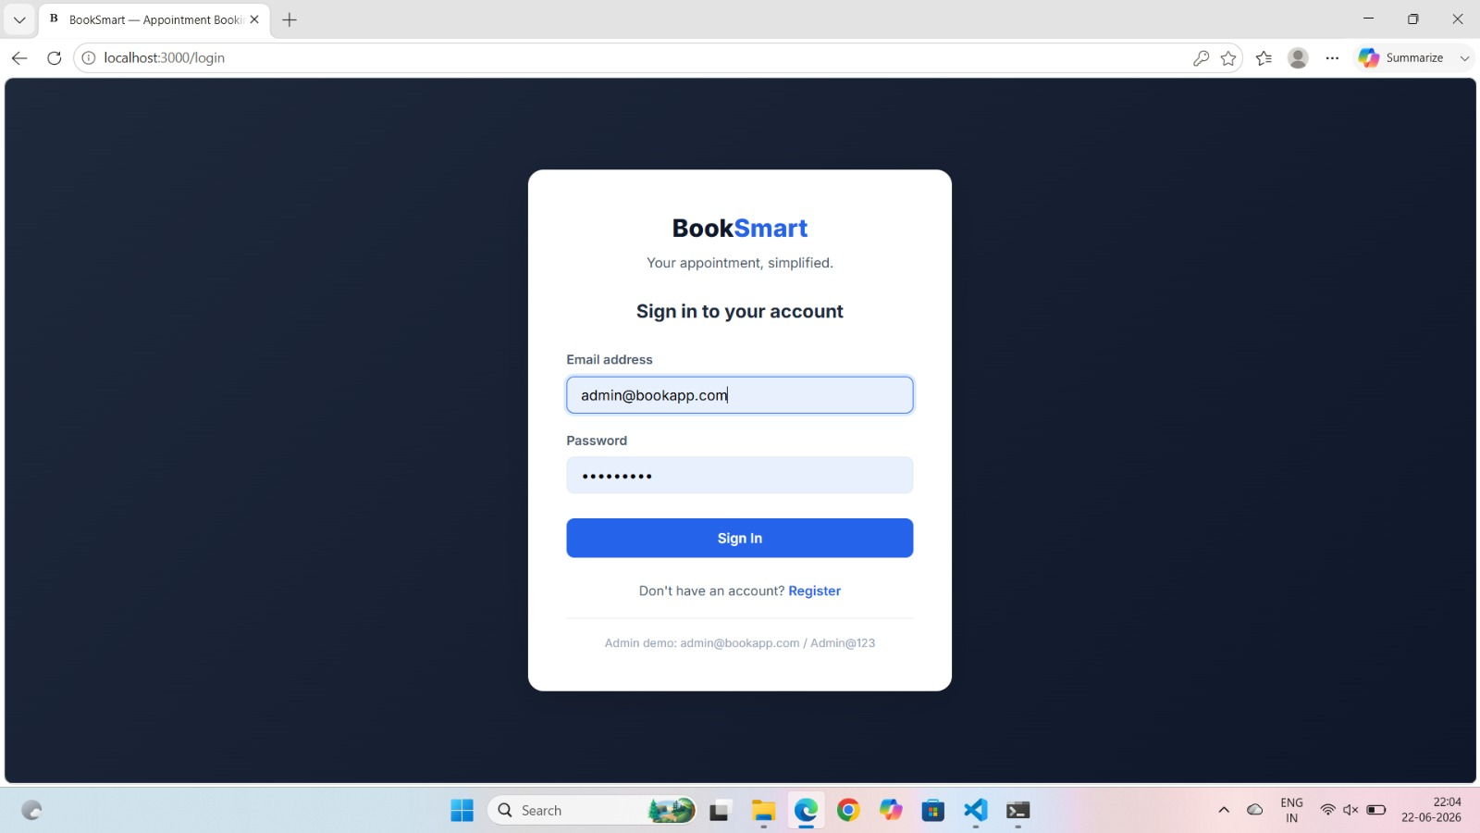
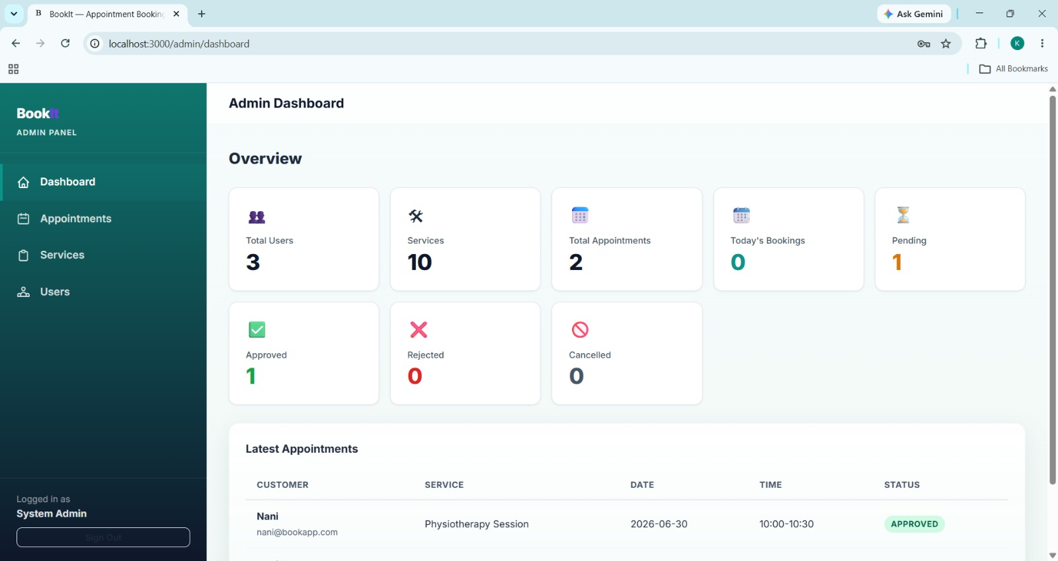
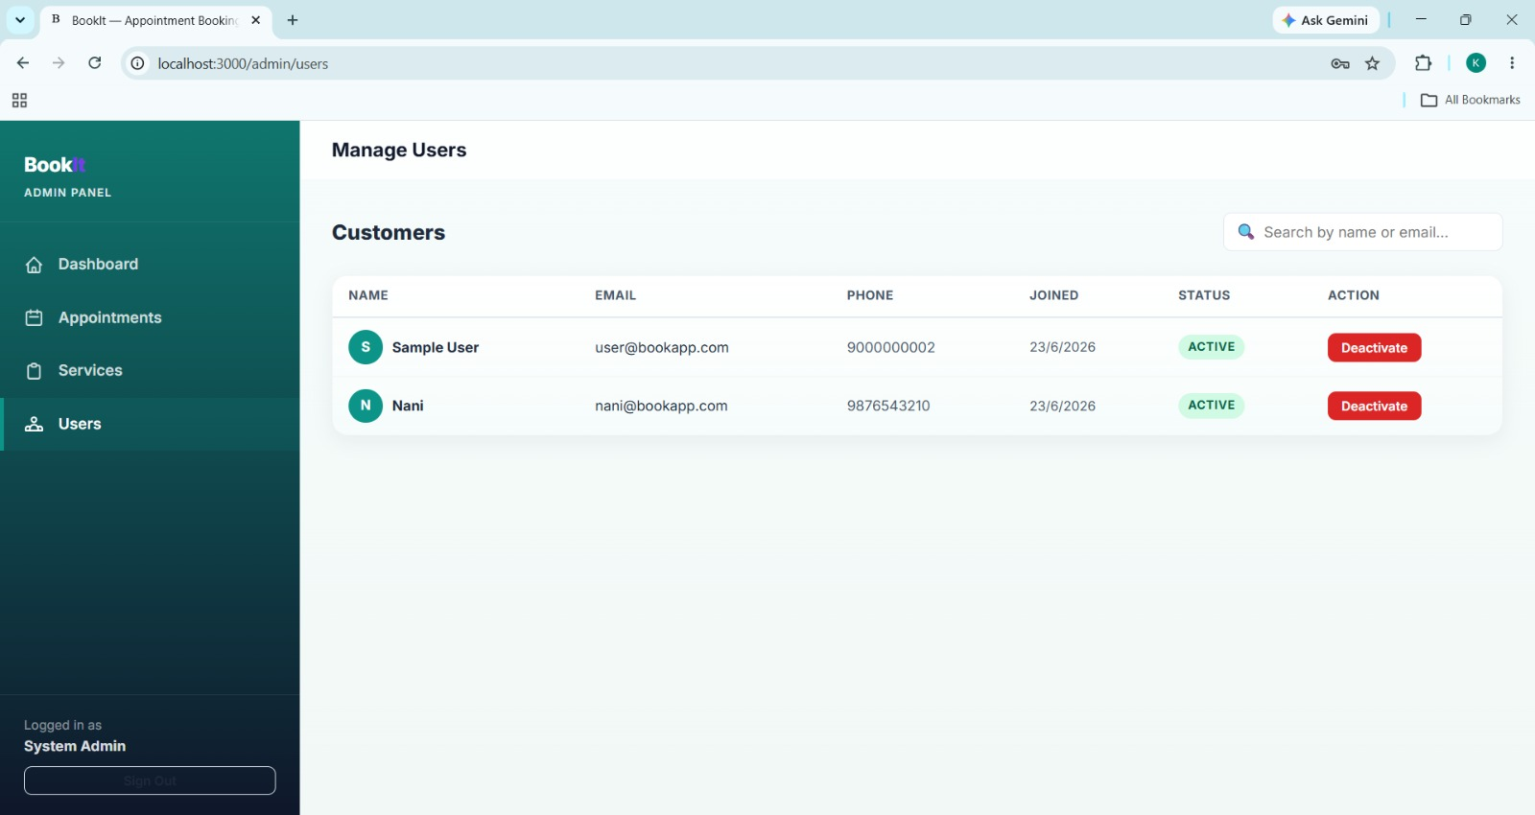
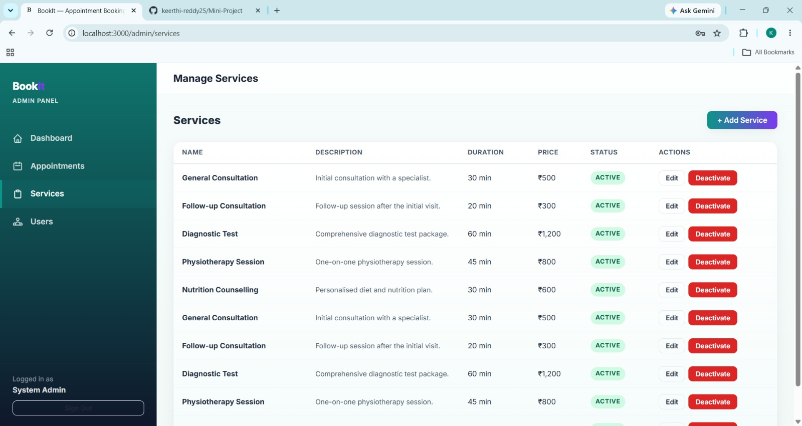
Admin Login

Slide 6

Conclusion
The BooKIT Appointment Booking System successfully digitizes the appointment scheduling process and improves efficiency through a secure and user-friendly platform.
Future Enhancements
Email Notifications
SMS Reminders
Online Payment Integration
Appointment Analytics and Reports
Mobile Application Support

